Slide 1


Gather & Analyse Data
IL “Scientific Method and Analysis” WS 25-26
Kami Höferl
(Wright of Derby , Wikimedia, PD)
Notes:
"The Alchemist in Search of the Philosopher’s Stone" by Joseph Wright of Derby (1771)
substance capable of turning base metals such as mercury into gold or silver[
In this work, Wright captures an alchemist conducting an experiment with a crucible in search of the philosopher’s stone. The painting portrays a moment of discovery and highlights the experimental process central to early chemistry, before the formalization of modern science.

Slide 2

Overview
Gathering (& Analysing) quantitative Data
Gathering (& Analysing) qualitative Data

Slide 3
Gathering (& Analysing) Quantitative Data

Slide 4
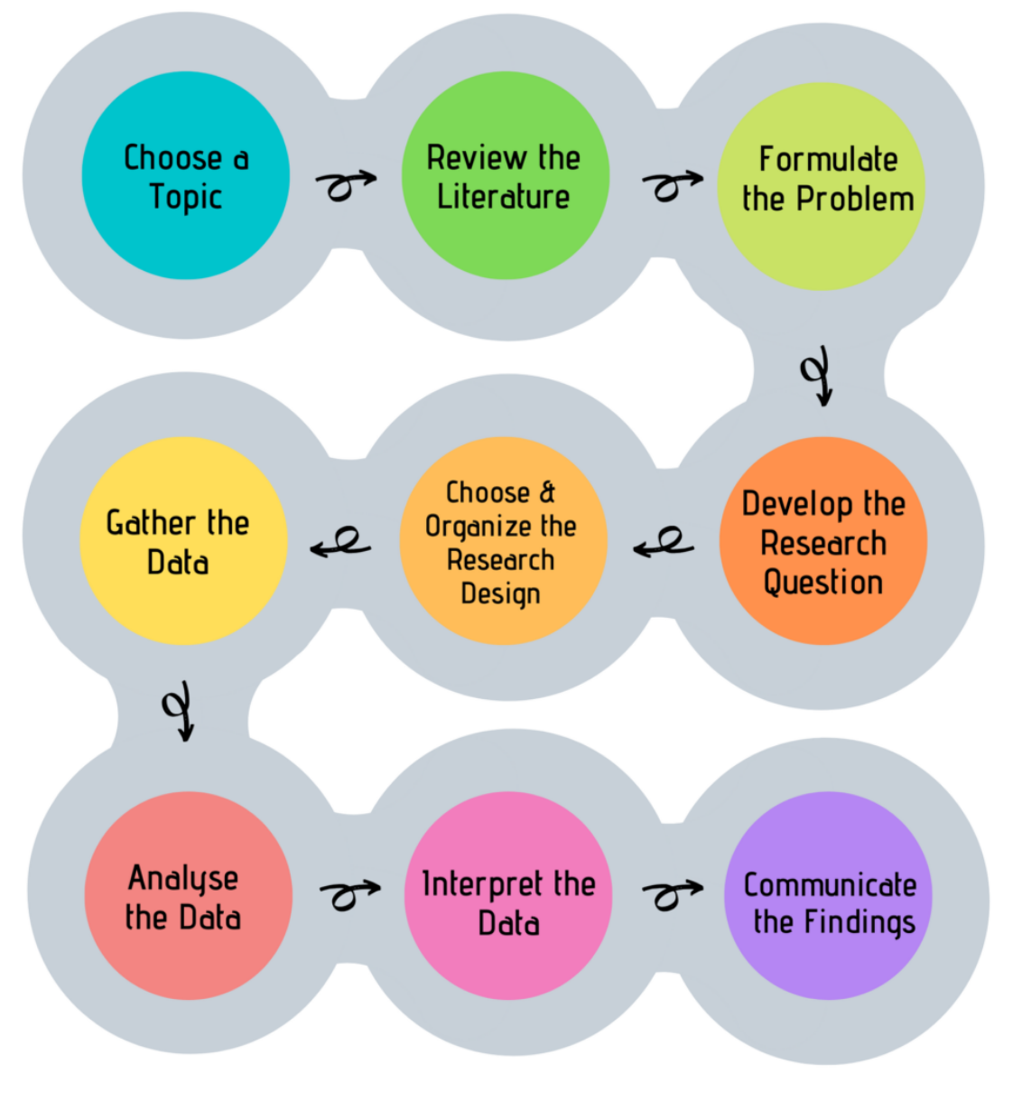
Look, Think, Test, Tell

Slide 5
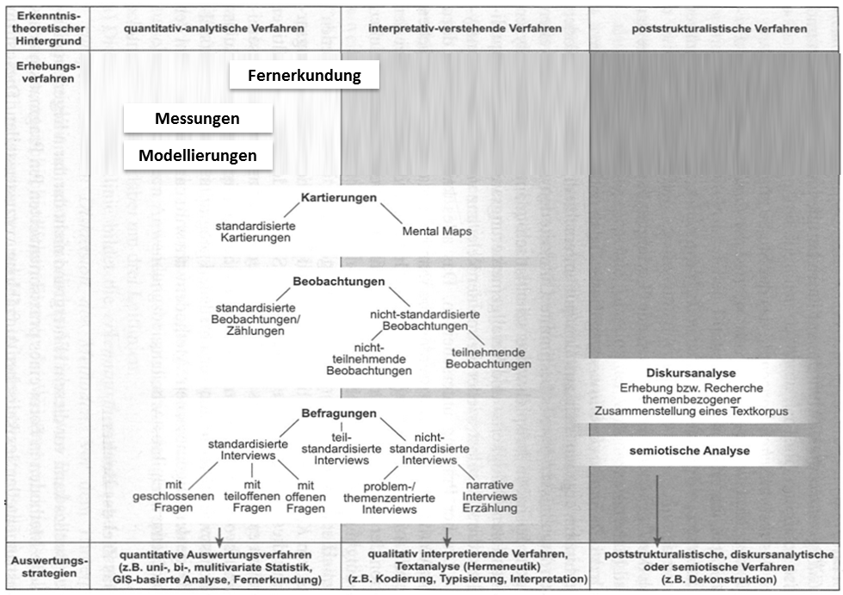
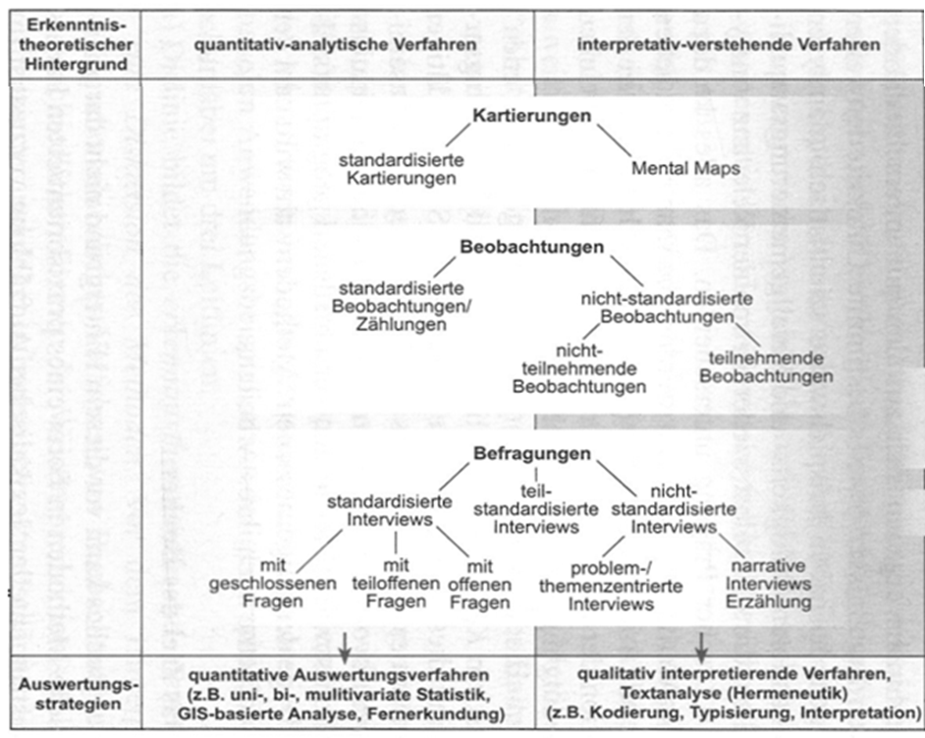
What Methods are There? An Overview

Slide 6
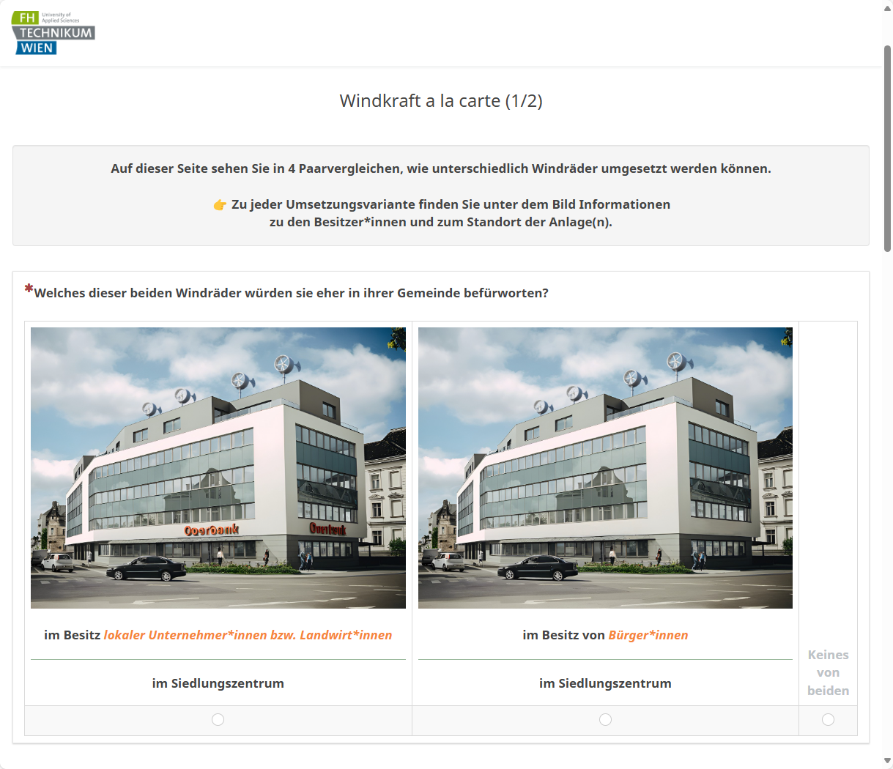
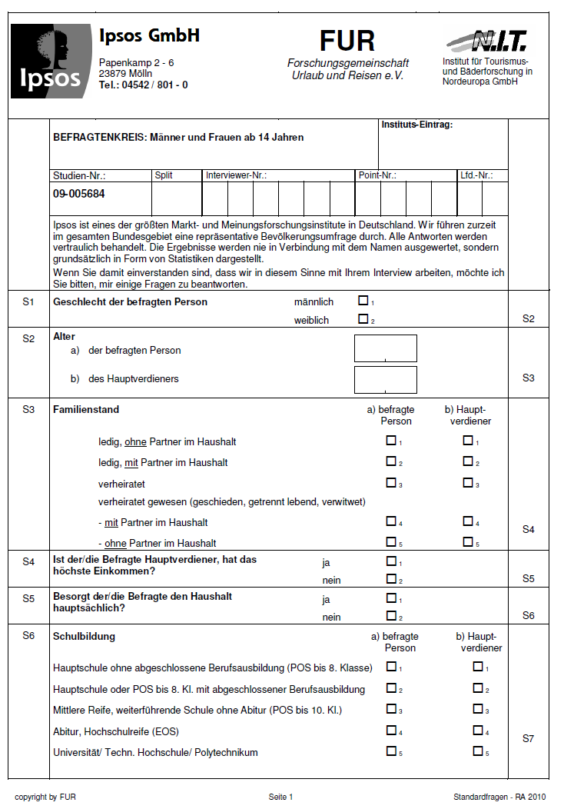
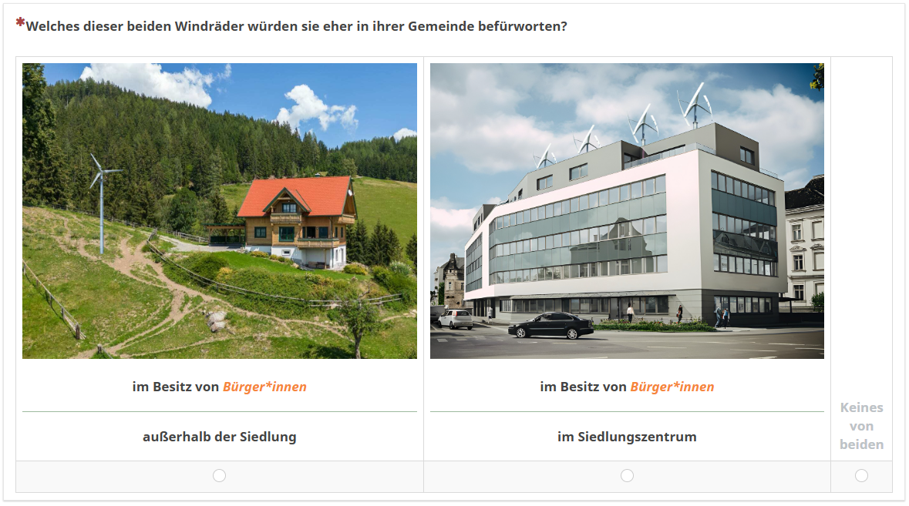
Why not a Survey?

Slide 7
The ideal empirical Workflow
Research question
Operationalisation
Objects of investigation
Selection survey instrument
Sampling
Field phase
Data preparation
Analysis & Interpretation
Document each step
Adhere to scientific quality criteria
refine research design
gather more data

Slide 8
Measurement in Surveys
Measurement = assignment of
a) characteristic values*
b) of characteristic carriers
c) to the characteristic dimensions to be observed.
* coded using number
Manifest Features | Latent Features
Directly measurable | Indirectly measurable (= via indicators)
Age Height Highest educational qualification Income … | Intelligence Sustainable behaviour Resilience / Vulnerability Study satisfaction …

Slide 9
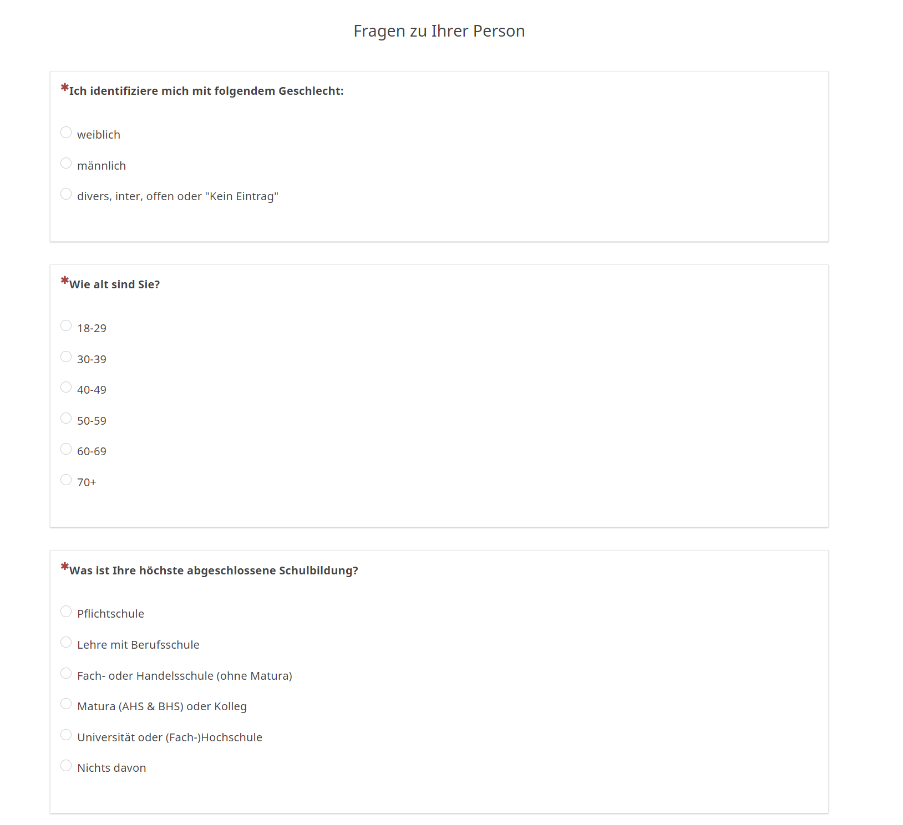
Measuring manifest Features

Slide 10
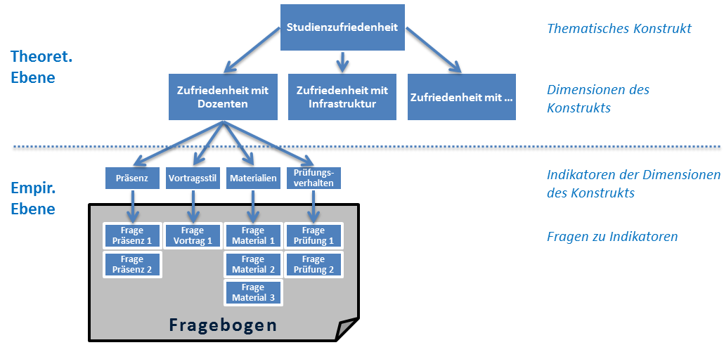
Measuring latent Features

Slide 11
The ideal empirical Workflow
Research question
Operationalisation
Objects of investigation
Selection survey instrument
Sampling
Field phase
Data preparation
Analysis & Interpretation
Document each step
Adhere to scientific quality criteria
refine research design
gather more data

Slide 12
Be clear on the Survey Units
Selection of survey units :
Who should be surveyed?
e.g. households, residents, passers-by, EV-car owner, members of energy communities, …
Selection criteria:
Spatial
Temporal
Characteristics of interest (e.g. migration background, income, education, etc.)
…

Slide 13
The ideal empirical Workflow
Research question
Operationalisation
Objects of investigation
Selection survey instrument
Sampling
Field phase
Data preparation
Analysis & Interpretation
Document each step
Adhere to scientific quality criteria
refine research design
gather more data

Slide 14
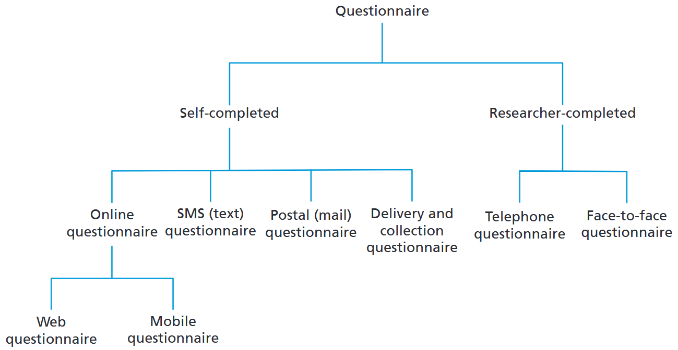
Operationalise your structured Survey

Slide 15
Operationalise your structured Survey

Slide 16
Operationalise your structured Survey
Open questions: Answers "in own words“:
Useful: answer options not fully known; spontaneous answers
Closed questions: Decision between predefined answer alternatives
Useful: Comparability of answers
Time and cost savings
Formulation weaknesses among respondents
Avoid excessive demands on the interviewer when taking notes

Slide 17
Requirements for Response Categories:
Exclusivity of the categories (→ multiple answers)
Completeness of the categories "Remaining category" → Partially open or hybrid questions (additional work in evaluation)
In your opinion, which natural hazards require action from local authorities? Avalanches Floods Other ___________________________________
Concretisation of categories
The respondent must be able to assign categories to observable facts
Limitation of the number of categories
5 to 7 categories

Slide 18
Often used: Scales for Intensities
👉 tool for converting empirical facts into numerical facts
Measurement of frequencies: never - rarely - occasionally - frequently - always
Measurement of intensities: not at all - a little - moderately - predominantly - completely
Measurement of probabilities: not at all - probably not - maybe - quite probably - definitely
Measurement of agreement ("Likert scale"): strongly agree - agree - neutral - tend to disagree – disagree
0 +1 +2 +3 +4
0 +1 +2 +3 +4
0 +1 +2 +3 +4
+2 +1 0 +1 +2

Slide 19
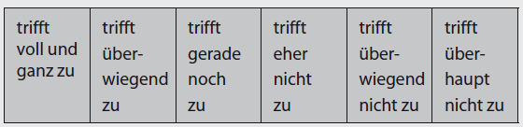
Often used: Scales for Intensities
👉 tool for converting empirical facts into numerical facts
Measurement of frequencies: never - rarely - occasionally - frequently - always
Measurement of intensities: not at all - a little - moderately - predominantly - completely
Measurement of probabilities: not at all - probably not - maybe - quite probably - definitely
Measurement of agreement ("Likert scale"): strongly agree - agree - neutral - tend to disagree – disagree
0 +1 +2 +3 +4
0 +1 +2 +3 +4
+3 +2 +1 -1 -2 -3
0 +1 +2 +3 +4
+2 +1 0 +1 +2

Slide 20
Some Suggestions for formulating Questions
Simple formulations: no technical terms, no double negatives, etc.
"I don't like walking alone„
Short & straight questions
Be specific: "the traffic situation"
(Miss-)Leading questions : "Don't you also mean ..."
Be careful* with emotionally "preloaded" terms
Avoid hypothetical questions: "Suppose you had ..."
Do not overwhelm respondents (e.g. percentages)

Slide 21
Some Suggestions for formulating Questions
questions: one-dimensional
"Are you in favour or against the expansion of XY to improve the traffic situation?"
Questions on distances, frequencies, etc.: 👉provide categories with specified units
"How often do you read a daily newspaper?"
Number of answer categories = „manageable"
5 to 7 categories

Slide 22
Order of Questions:
👉 it depends on the respondents (panel or volunteers)
Introduction:
Make the benefits & purpose of the survey clear
Icebreaker questions: simple questions for introduction
Easy to answer & arouse interest
Main part: core questions on content
Difficult or monotonous questions (blocks)
Funnelling: From the general to the specifi
End:
Demographic characteristics
Length:
Rule of Thumb: < 15 min.

Slide 23
The ideal empirical Workflow
Research question
Operationalisation
Objects of investigation
Selection survey instrument
Sampling
Field phase
Data preparation
Analysis & Interpretation
Document each step
Adhere to scientific quality criteria
refine research design
gather more data

Slide 24
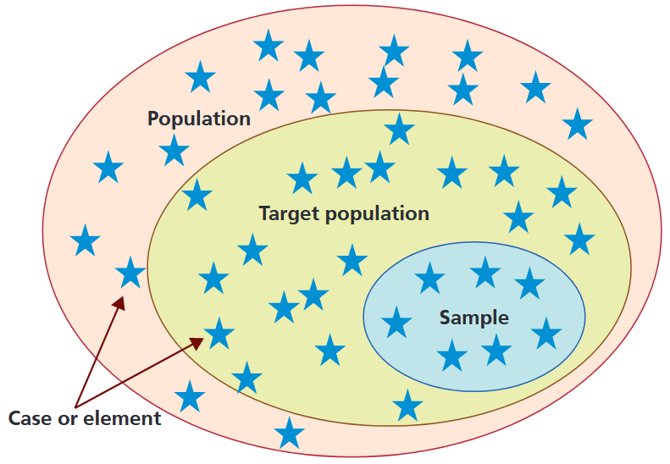
Why is Sampling important?
"Representative":
every element of the population → equal chance of being included in the sample
👉 structural equality = frequency distribution of "important" characteristics in the population exactly reproduced
Prerequisite for drawing conclusions about the population (e.g. ranges)

Slide 25
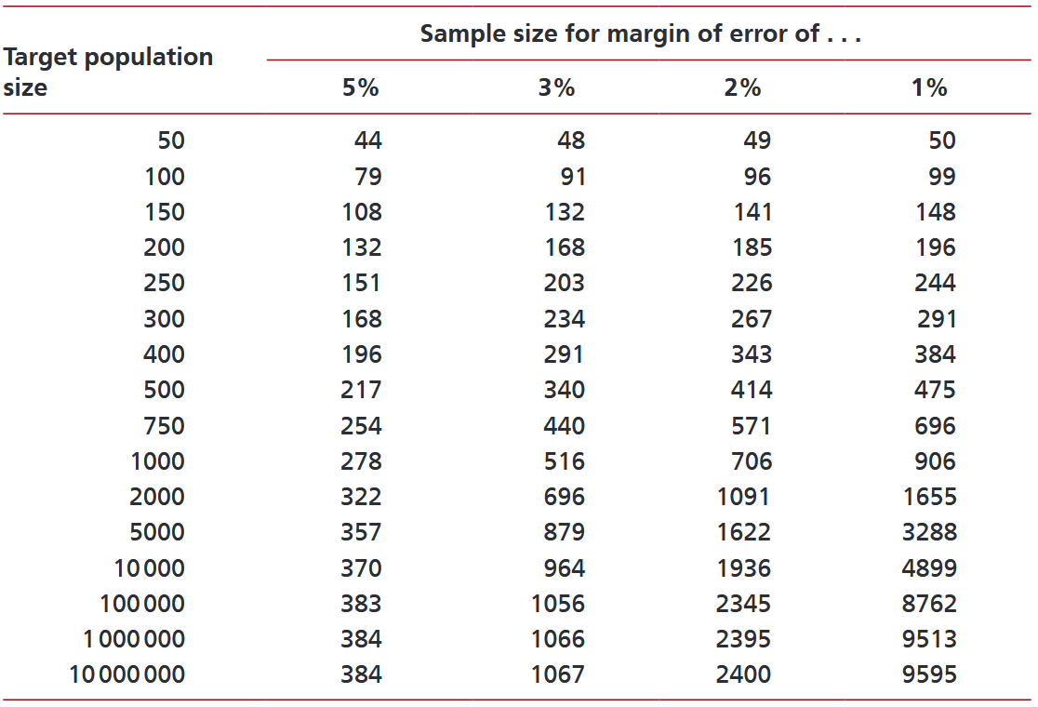
Why is Sampling important?
*
* … based on a 95% confidence level

Slide 26
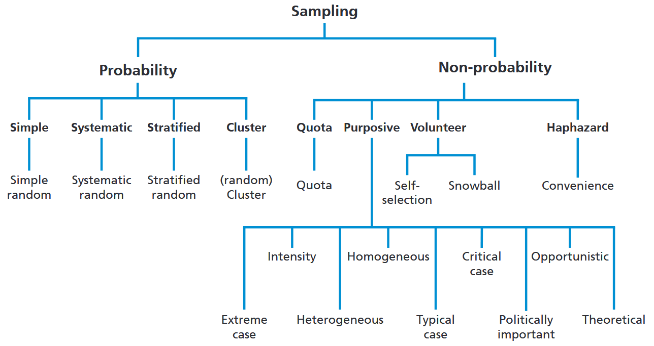
Overview Sampling Strategies

Slide 27
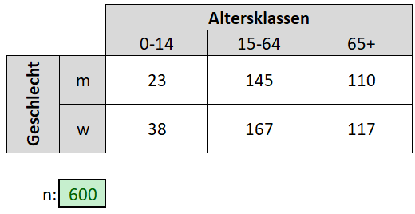
A simple Quota Sampling

Slide 28
The ideal empirical Workflow
Research question
Operationalisation
Objects of investigation
Selection survey instrument
Sampling
Field phase
Data preparation
Analysis & Interpretation
Document each step
Adhere to scientific quality criteria
refine research design
gather more data

Slide 29
Data Preparation: Make it digital!
Data = material that represents (social) facts
Usually not directly analysable:
"the" interview, "the" questionnaire
For classical pen & paper questionaires:
Coding of response items 👉 Coding Scheme & Coder Training
Digitisation

Slide 30
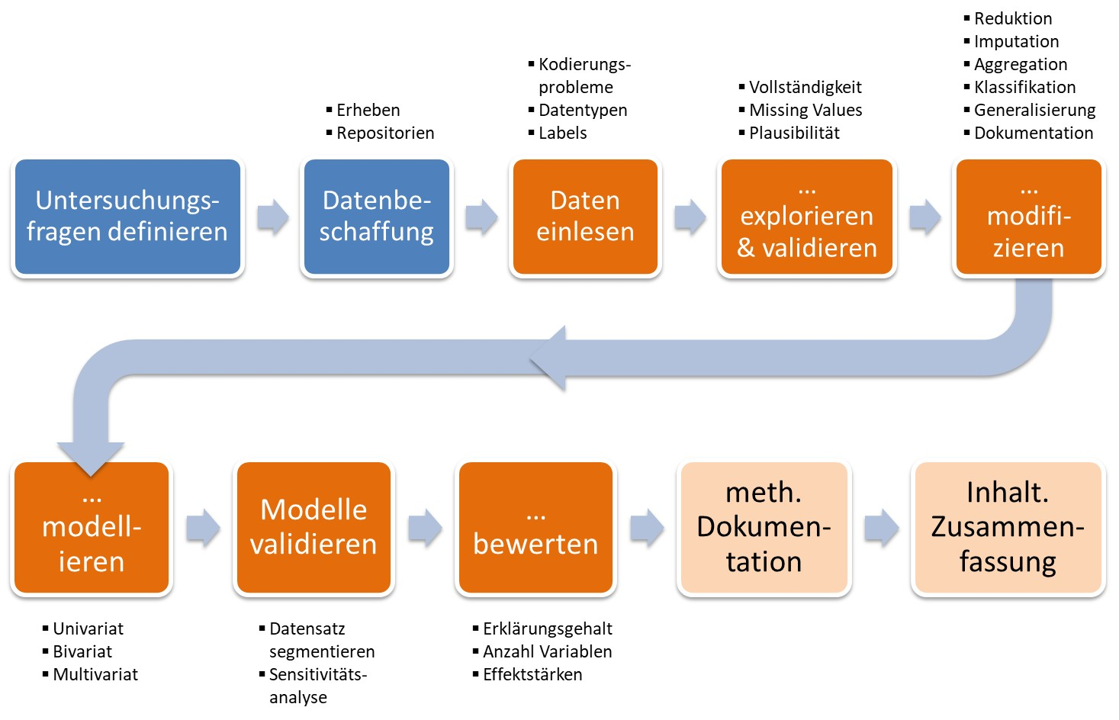
And then: Welcome to the Data Workflow

Slide 31
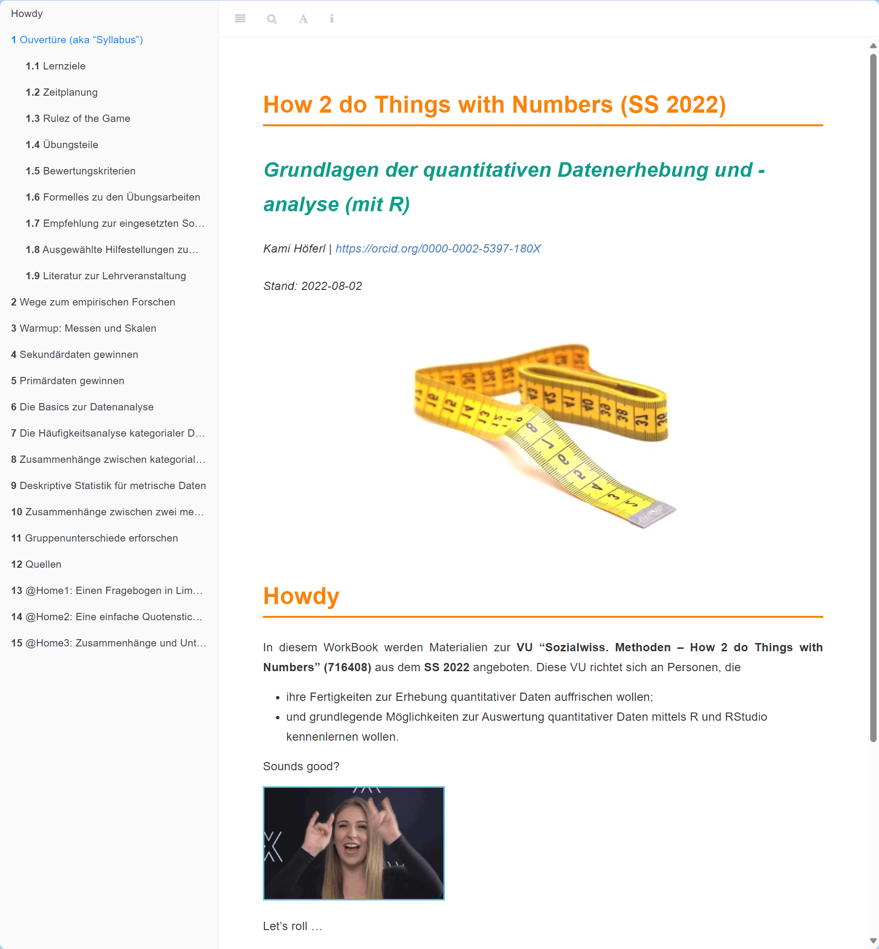
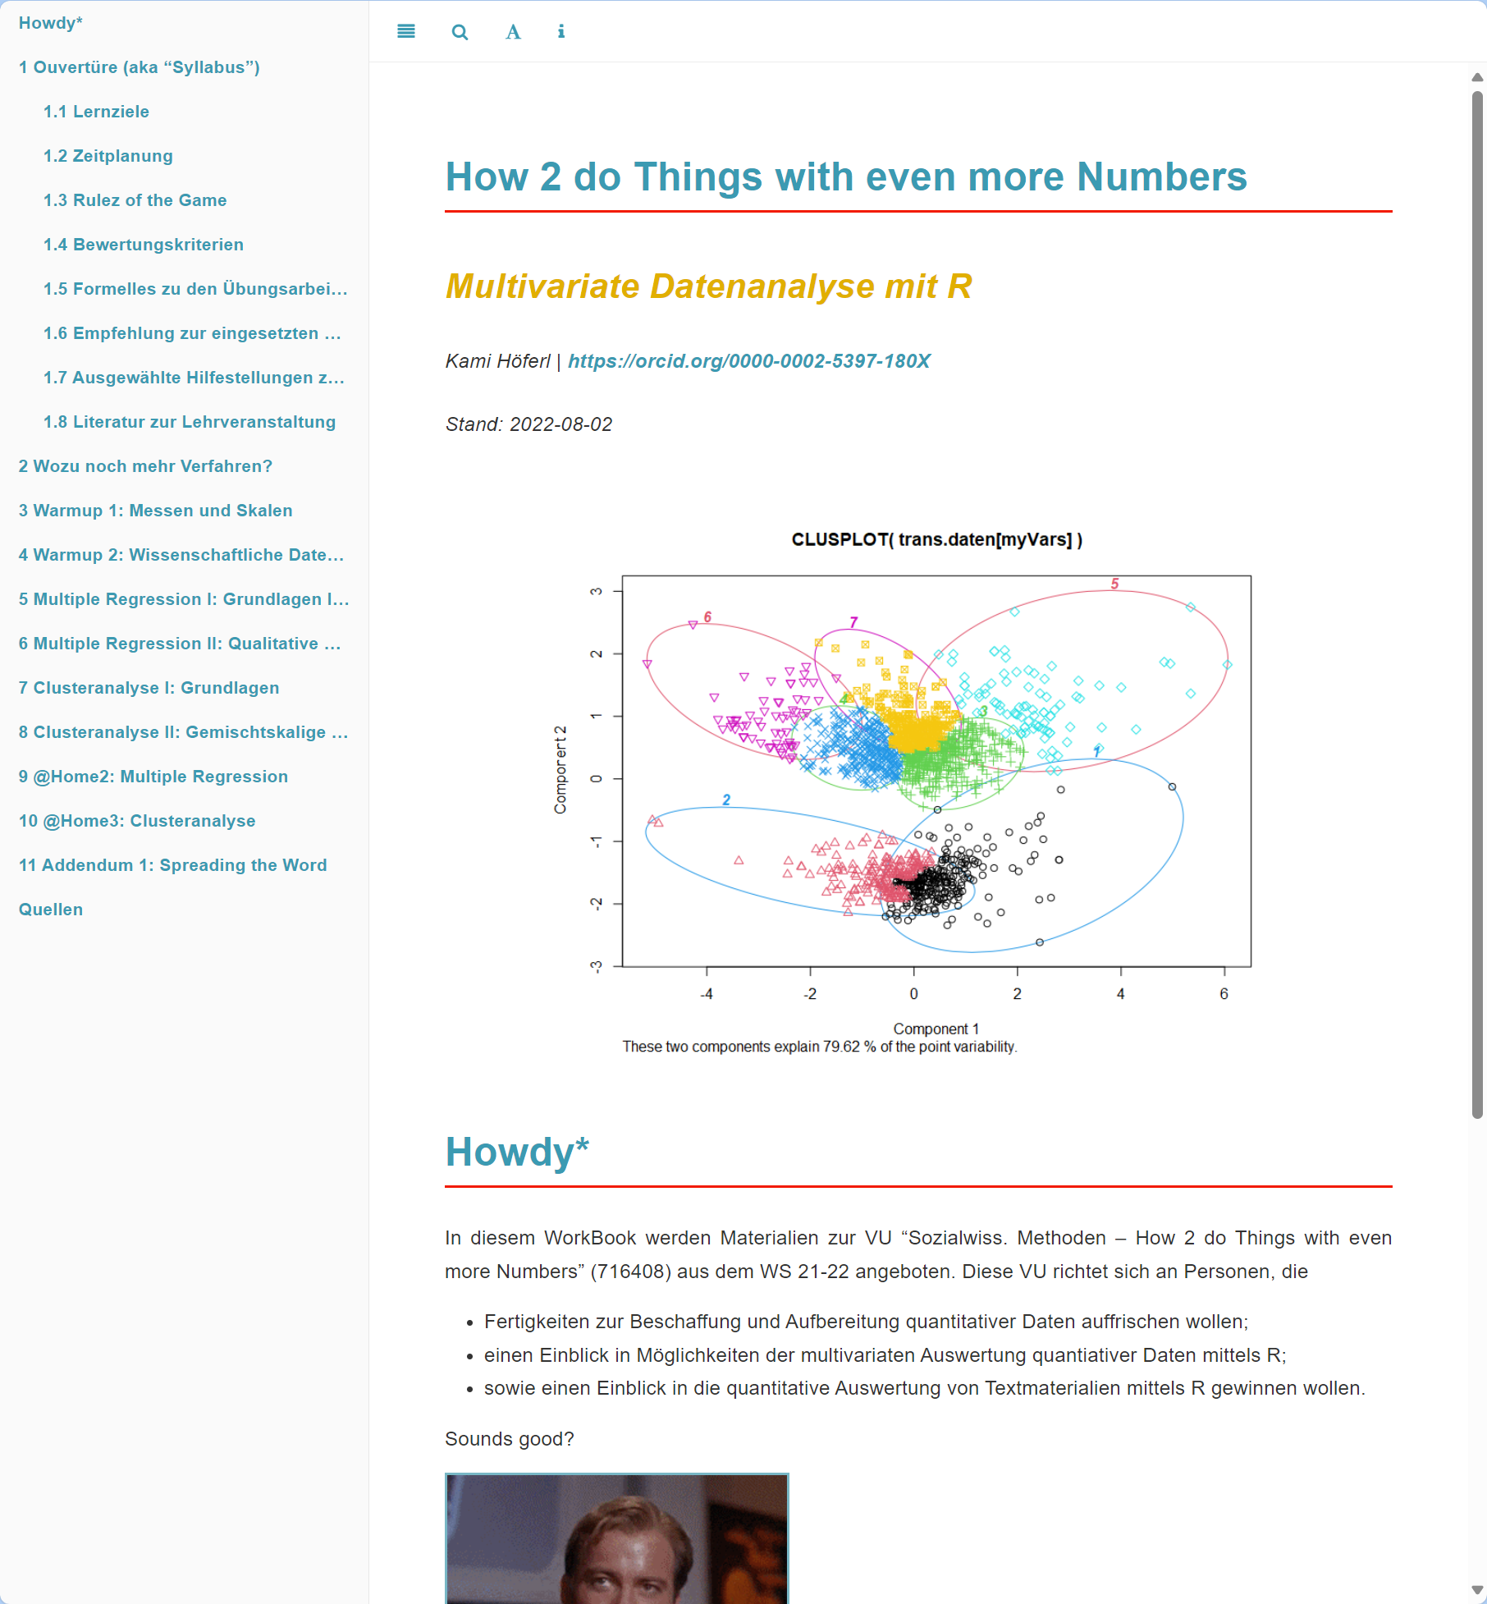
Grab the Data and run …

Slide 32
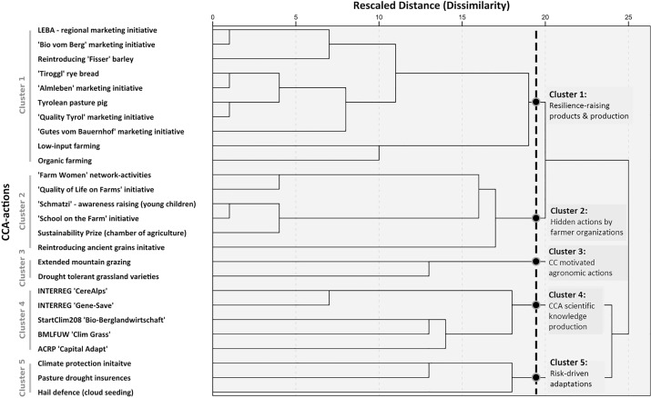
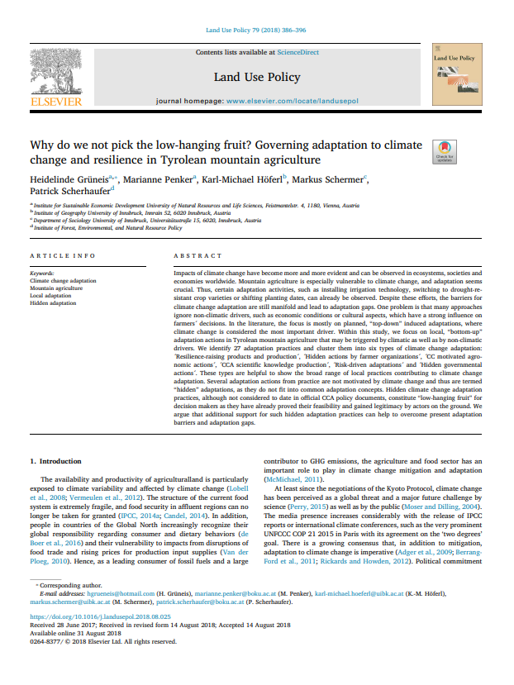
An Example for Quantitative Analysis:

Slide 33
Gathering (& Analysing) Qualitative Data

Slide 34
Look, Think, Test, Tell

Slide 35
What Methods are There? An Overview

Slide 36

The qualitative Interview
Aim: "subjective view of actors about past events, future plans, opinions, health complaints, relationship problems, experiences in the world of work, etc.“ (Bortz & Döring 2009:308)
Based on open questions → Allows interviewees room for manoeuvre when answering
Takes into account interaction between interviewer and interviewee → follow-up questions etc.
Takes into account impressions & interpretations of the interviewer

Slide 37
Workflow
1. Content preparation
2. Organisational preparation
3. Start of conversation
„Interview“
4. Conducting the interview
5. End of conversation & farewell
6. Interview notes
7.Transcription
8. Content analysis

Slide 38

1. Preparation of Content
Definition of survey topic (possibly theoretical background):
Sub-questions: restrictions, development (possibilities), hist. development etc.
👉 Key decisions:
Sampling: Selection of persons to be interviewed
Survey technique: Selection of a suitable survey technique for the survey topic

Slide 39
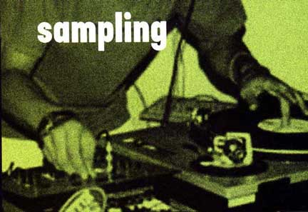
@ Sampling
The "total survey":
For small populations
Deliberate selection:
"Gatekeeper"
Experts
Max/min Contrast
Extreme cases
"Typical" cases
Snowball method:
Ask interviewees about other people to be interviewed
→ no representativeness: „thick" description = cancellation criterion

Slide 40
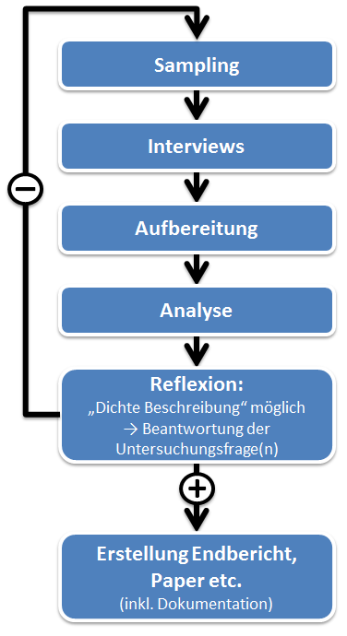
Digression: How many interviews do you need?
Basically: number of interviews = f(research question)
„Thick description": new material 👉 no new description nor interpretation
Pragmatic: dependent on
Resources: time, money & personnel
Who do I want to investigate (= object of investigation)
Rough estimate (MSc.): ~ 10 interviews

Slide 41
Digression: “Thick Description”?
Rich Context: Explains the setting, participants, and circumstances in detail, helping the reader understand the environment in which the phenomenon occurs
Multiple Perspectives: Incorporates diverse viewpoints and experiences to capture the complexity of the situation
Meaning and Interpretation: Goes beyond describing "what happened" to explore "why" and "how" events and behaviours hold particular meanings for participants
Layered Analysis: Links empirical observations to theoretical insights, showing how the data connects to broader social or cultural contexts
Grounded in Data: Stays faithful to the principles of grounded theory by basing interpretations and descriptions directly on empirical data.

Slide 42
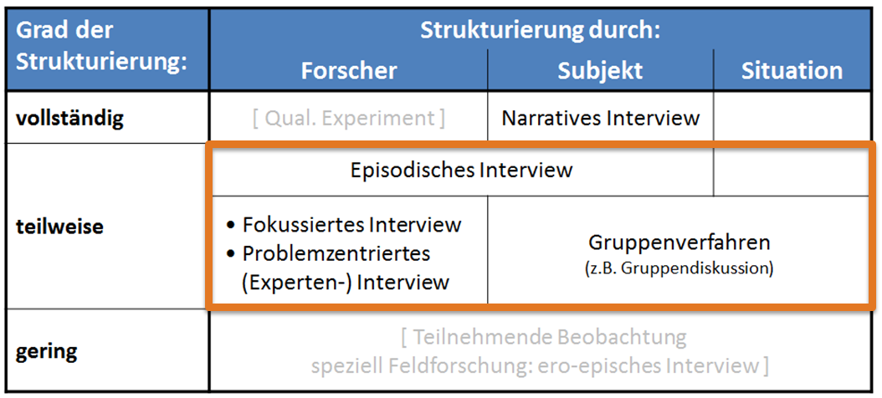
Types of qualitative Interviews

Slide 43
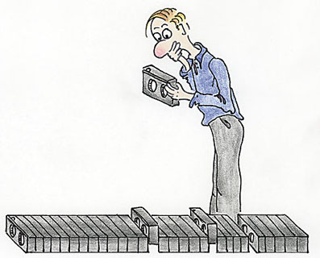
The episodic interview
Goal: discover regularities and rules on the basis of experience (inductive)
Experiences with objects of investigation are based on
narrative-episodic knowledge and
derived from this "semantic" knowledge: generalisations & abstractions
Interviewer lets interviewee narrate, but also asks "own" questions 👉 Combination of narration & targeted questions
Guideline necessary
Possible applications:
Group-specific differences in experiential knowledge

Slide 44
Types of qualitative Interviews

Slide 45
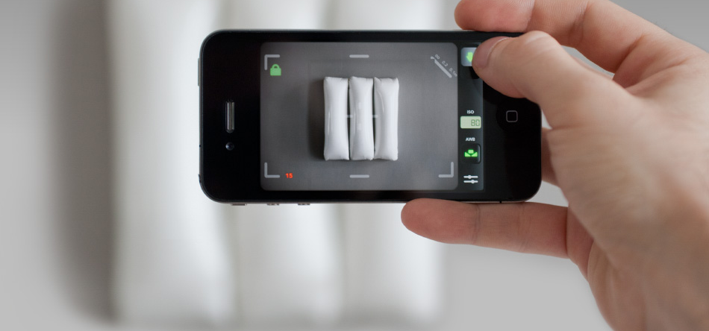
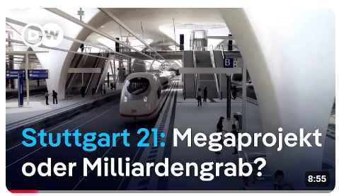
The focussed interview
Objective: Based on a stimulus (e.g. film, planning, etc.), develop & test hypotheses on subjective experiences, perceptions & relevant elements
"Deductive" variant: validate hypotheses in advance & in the interview
Preliminary examination of stimulus on a theoret. Level 👉 guide
Contradiction to respondents' reactions 👉 reject/modify hypotheses
"Inductive" variant: filter out structures in the interviewees' responses 👉 derive theory/hypothesis from this
Transition to narrative interview

Slide 46
Types of qualitative Interviews

Slide 47

The problem-centred interview I
Objective: To check and modify a scientific concept on a relevant problem through the interviewee's statements
Due to prior understanding: Active interviewer asks questions on a "relevant" social problem
Before the interview: Acquire specialist knowledge 👉 structured guide
Theoretical concept not mentioned to interviewee → Openness
If contradiction to the respondent's structuring of meaning 👉 Adaptation of the theoretical concept

Slide 48
The problem-centred interview II
Procedure:
general exploration: narrative example 👉 compulsion to go into detail
Specific details of interrest: Refined question strategies
Reflect back: What has been said in your own words
Comprehension questions: for contradictory answers
Confrontation: contradictions, unexplained issues, etc.
Combination with short questionnaire possible
Examples:
Reconstruction of behaviour patterns of specific actors in dealing with problem

Slide 49
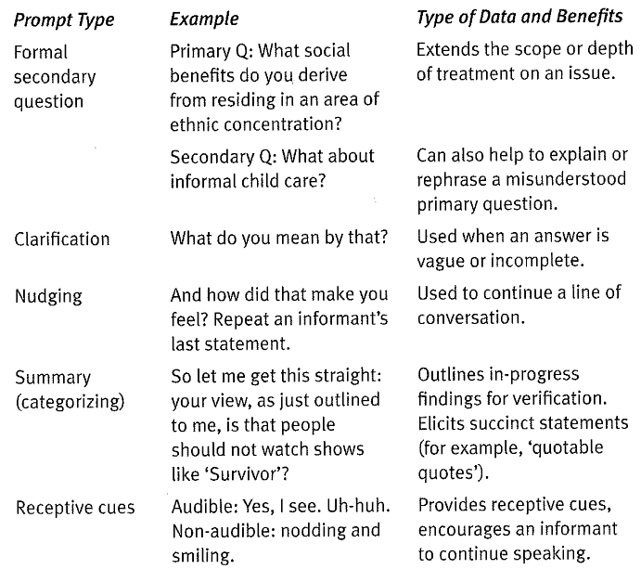
@ Refined Question Strategies during the Interview

Slide 50

Digression: The Interview Guide
Partial standardisation
Content-related considerations on a topic area
👉 Useful if prior knowledge of the topic already exists & certain questions should be at the centre
Contents:
Topics to be addressed in a reasonable order
Possible formulation suggestions / key points
→ Order not necessarily specified, arises in the course of the conversation
→ Tick off questions so as not to forget anything

Slide 51
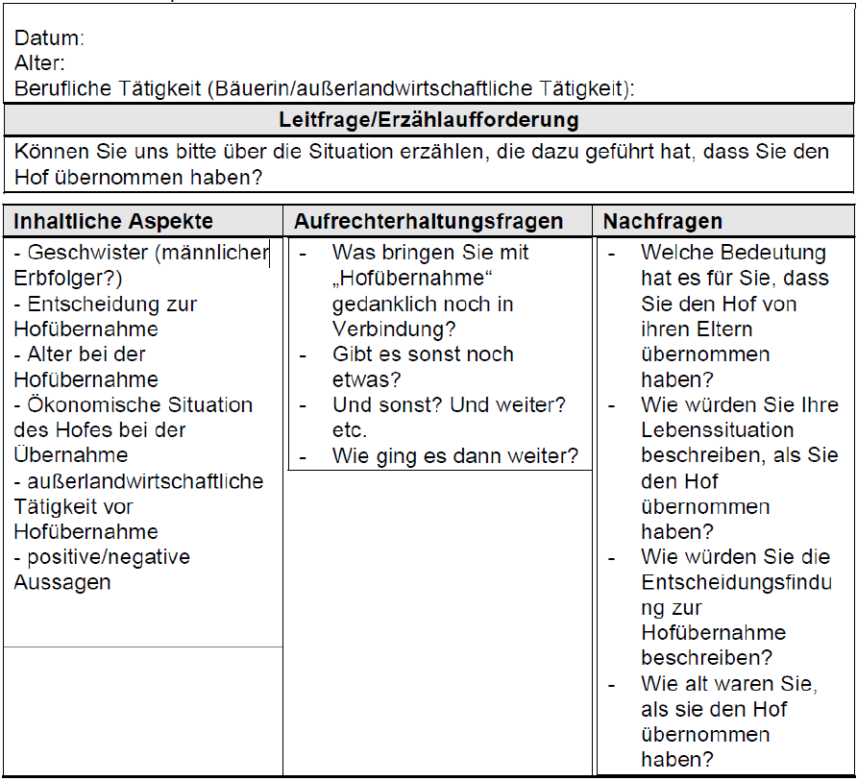
Digression: The Interview Guide
Example „Hofübernahme durch Frauen“ (Heistinger 2006)

Slide 52
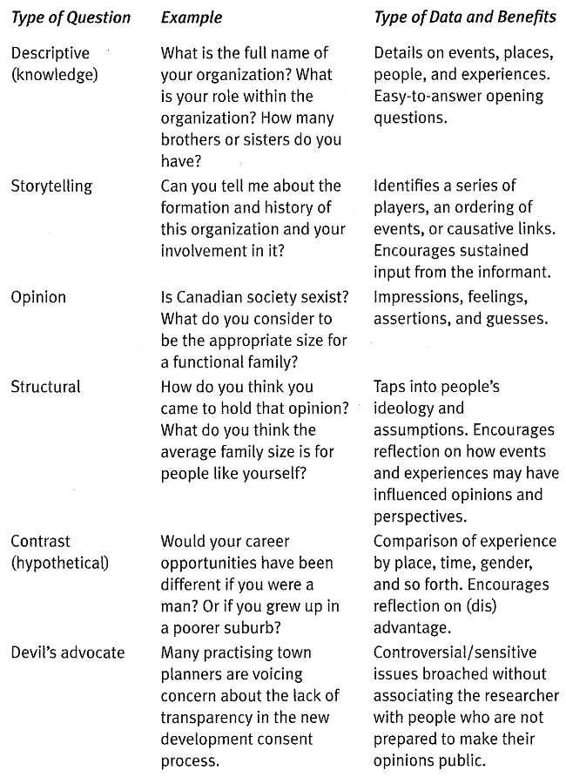
Question Types for the Interview Guide

Slide 53
Workflow
1. Content preparation
2. Organisational preparation
3. Start of conversation
„Interview“
4. Conducting the interview
5. End of conversation & farewell
6. Interview notes
7.Transcription
8. Content analysis

Slide 54
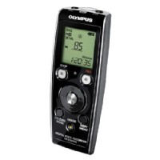
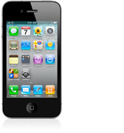
The Workflow
2. Organisational preparation:
Making contact:
Presentation of the topic, purpose of the study, utilisation, etc.
Appointments (👉 interview location)
Hardware:
Training Recording devices, spare batteries, business cards, etc.
3. Start of conversation:
Reference to recording* (& start it 😉)
Introduction & small talk 👉 relaxed atmosphere
4. Conducting the interview:
Managing the process 👉 using guidelines

Slide 55
Workflow
1. Content preparation
2. Organisational preparation
3. Start of conversation
„Interview“
4. Conducting the interview
5. End of conversation & farewell
6. Interview notes
7.Transcription
8. Content analysis

Slide 56
The Workflow
5. End of conversation & farewell:
Ending the audio recording
Start informal conversation👉 attention & keyword protocol
Farewell:
Business card, information material, utilisation of the results, etc.
6. (Ex post) Interview notes
Additional information on the interview situation
Description of interviewee, interruptions, premises, start & end of interview etc.
Hypotheses, thoughts, striking "sayings" &amp; associated associations

Slide 57
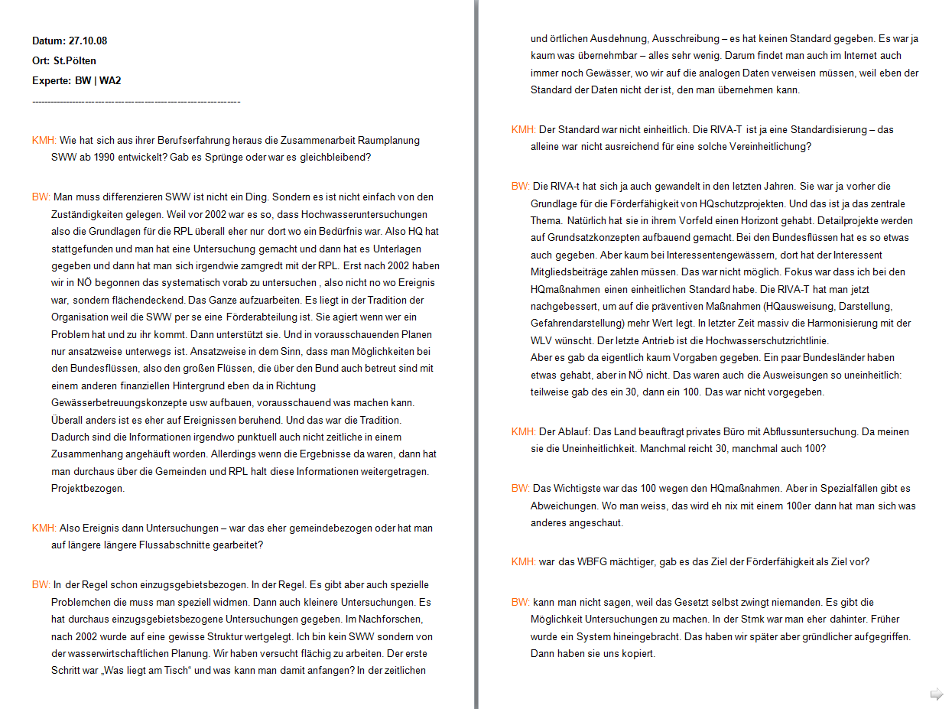
7. Transcription
Mark speakers with capital letters
Blank lines for speaker changes
No "formatting bells and whistles"

Slide 58
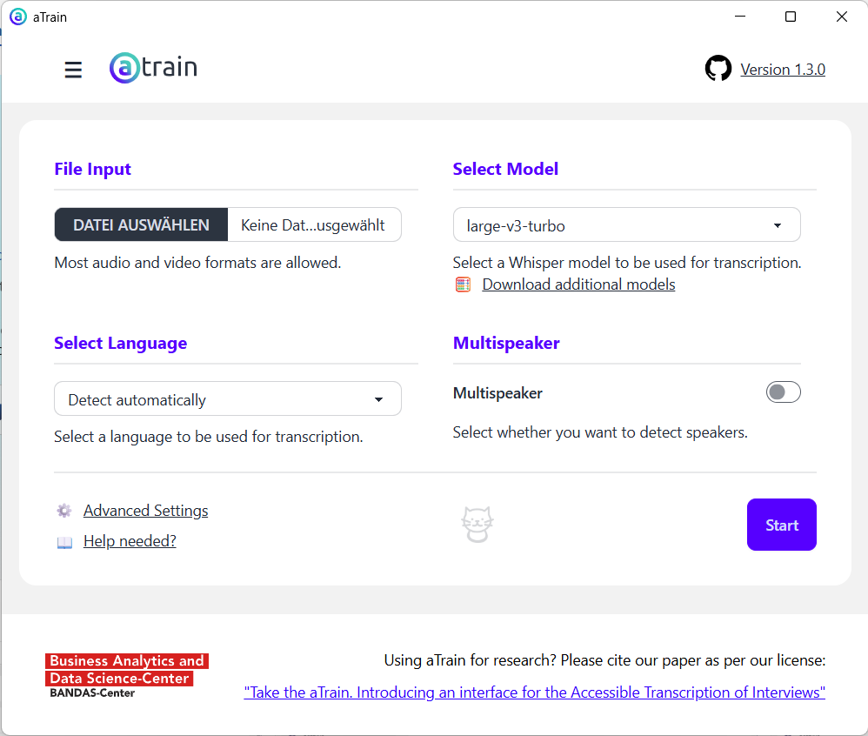
7. Transcription: Selber machen lassen 😉

Slide 59
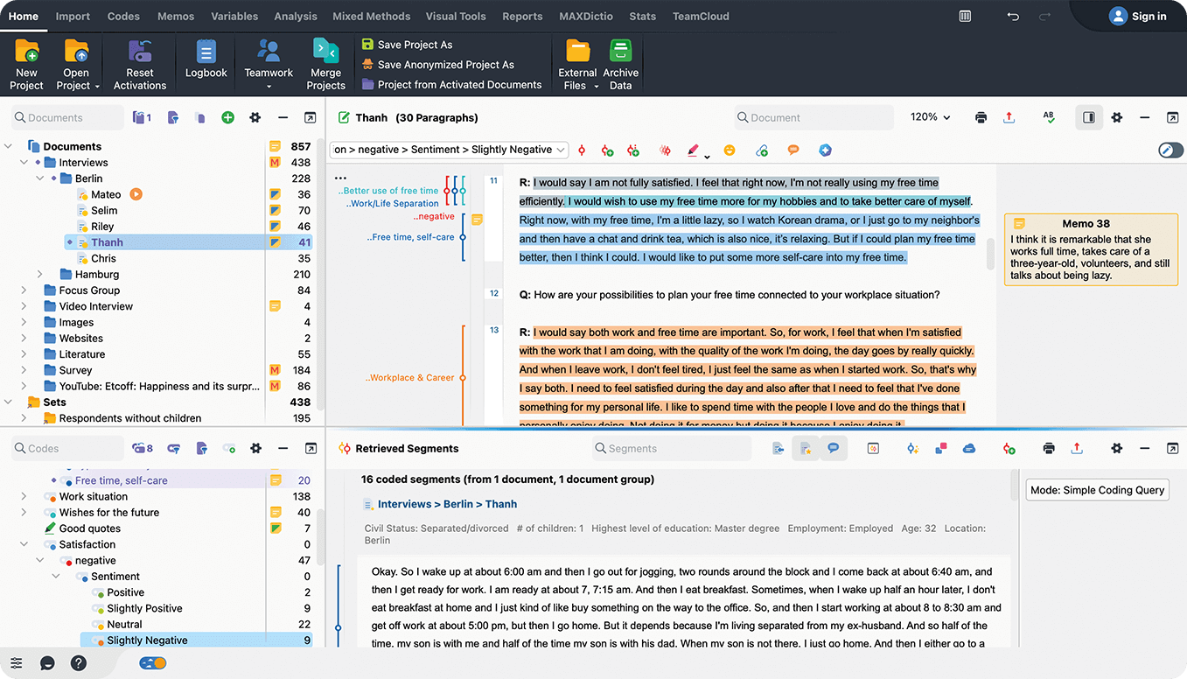
8) Qualitative Content Analysis

Slide 60
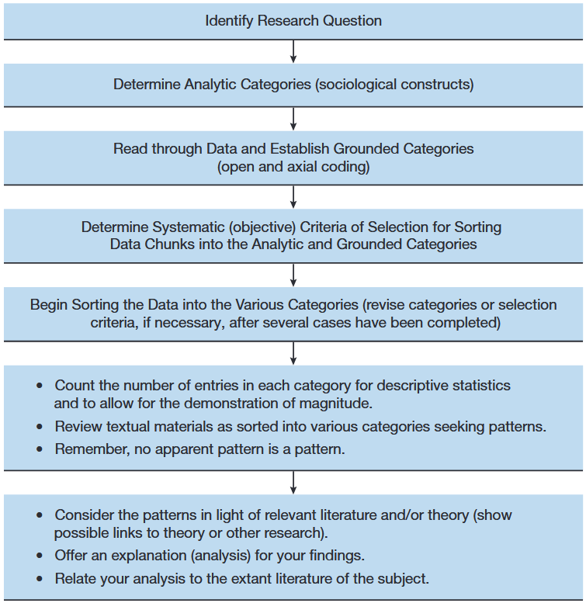
8) Qualitative Content Analysis
A) Qualitative content analysis:
Systematic method to analyse and interpret communication content.
texts, images, or media
Identifies patterns, themes, or meanings
Involves coding and categorising data

Slide 61
One Approach: Thematic Coding (cf. Hopf et al 1995):
Development of evaluation categories
Coding the material
Quant. material overview
Optional: In-depth interpretation of individual cases

Slide 62
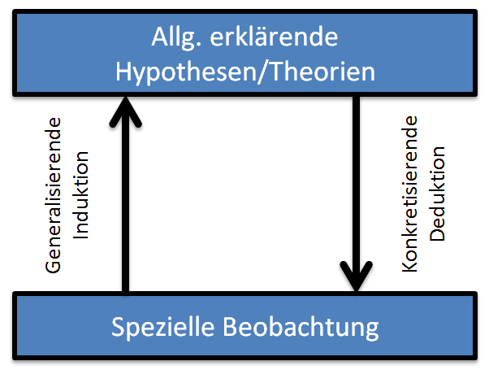
One Approach: Thematic Coding (cf. Hopf et al 1995):
Development of evaluation categories:
Theory-based "drafts": parallel to the development of interview guidelines
E.g. attitude towards citizen participation
Deductive approach: theory-based inference of category system
Inductive approach: from the examination of the research corpus 👉 categories 👉 abstraction leads to summarised units of meaning
Often: Combination of a & b 👉 cf. “Abductive Reasdoning”

Slide 63
One Approach: Thematic Coding (cf. Hopf et al 1995):
Creating a coding guide
Nr. | Category | Definition | Manifestations | Examples | Coding rules
2 | Reason for participation | Reason for voluntarily conducting a stakeholder participation | Citizen protest Instructions from above Legal requirement Political will other | … | When the board decides, it is always a matter of "political will". in internal circulars "Instructions from above“ …

Slide 64
One Approach: Thematic Coding (cf. Hopf et al 1995):
Creating a coding guide
Nr. | Category | Definition | Manifestations | Examples | Coding rules
2 | Reason for participation | Reason for voluntarily conducting a stakeholder participation | Citizen protest Instructions from above Legal requirement Political will other | … | When the board decides, it is always a matter of "political will". in internal circulars "Instructions from above“ …
Deductive: from literature review
Inductive: from interviews & materials

Slide 65
One Approach: Thematic Coding (cf. Hopf et al 1995):
Coding the material:
Using the coding guide: Mark passages with explicit or implicit statements about categories of interest (= code them)
Quant. Material overview:
→ usually only useful for multiple interviews
Overview of respondents and their characteristic constellations
👉 Inspiration for Interpretation & theory formation

Slide 66
8) Qualitative Content Analysis: An Example

Slide 67
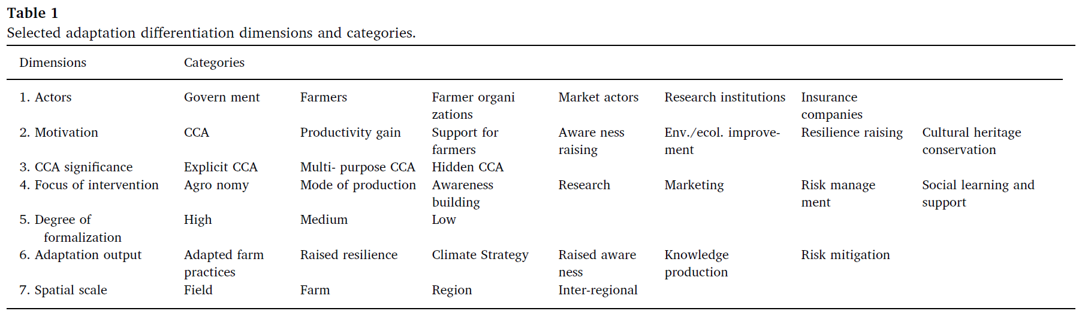
8) Qualitative Content Analysis: An Example
Deductive: from literature review
Inductive: from interviews & materials
Notes:
N: 27

Slide 68
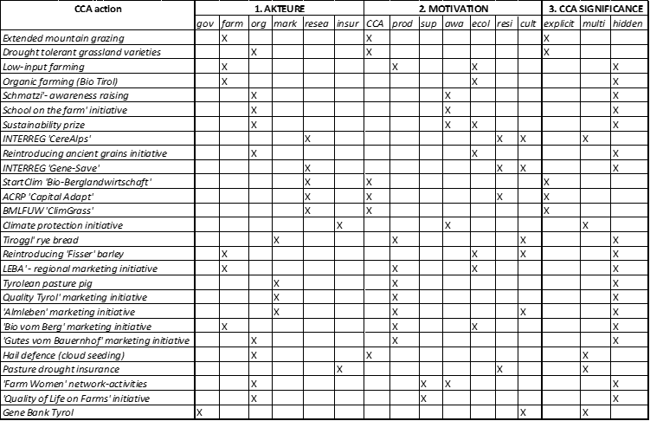
8) Qualitative Content Analysis: An Example
Notes:
N: 27

Slide 69
8) From Qualitative Content Analysis to Triangulation: Combining Qualitative and Quantitative Analyis

Slide 70
Wrap it up

Slide 71
Wrap it up
XXX

Slide 72
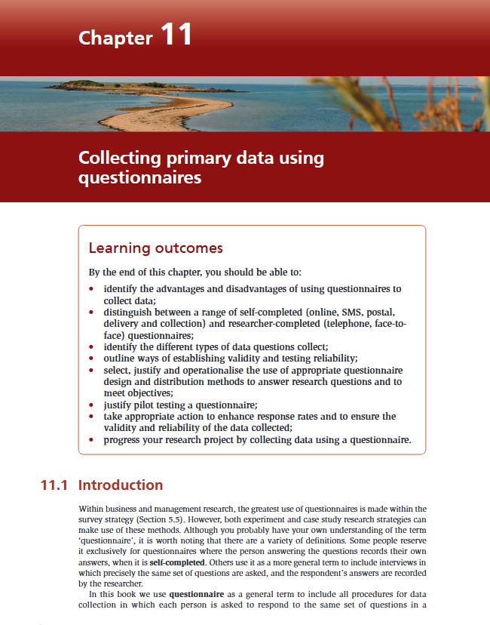
Till next session:
Chapters 11.2 & 11.5 on questionnaires from Saunders et al. (2023)

Slide 73
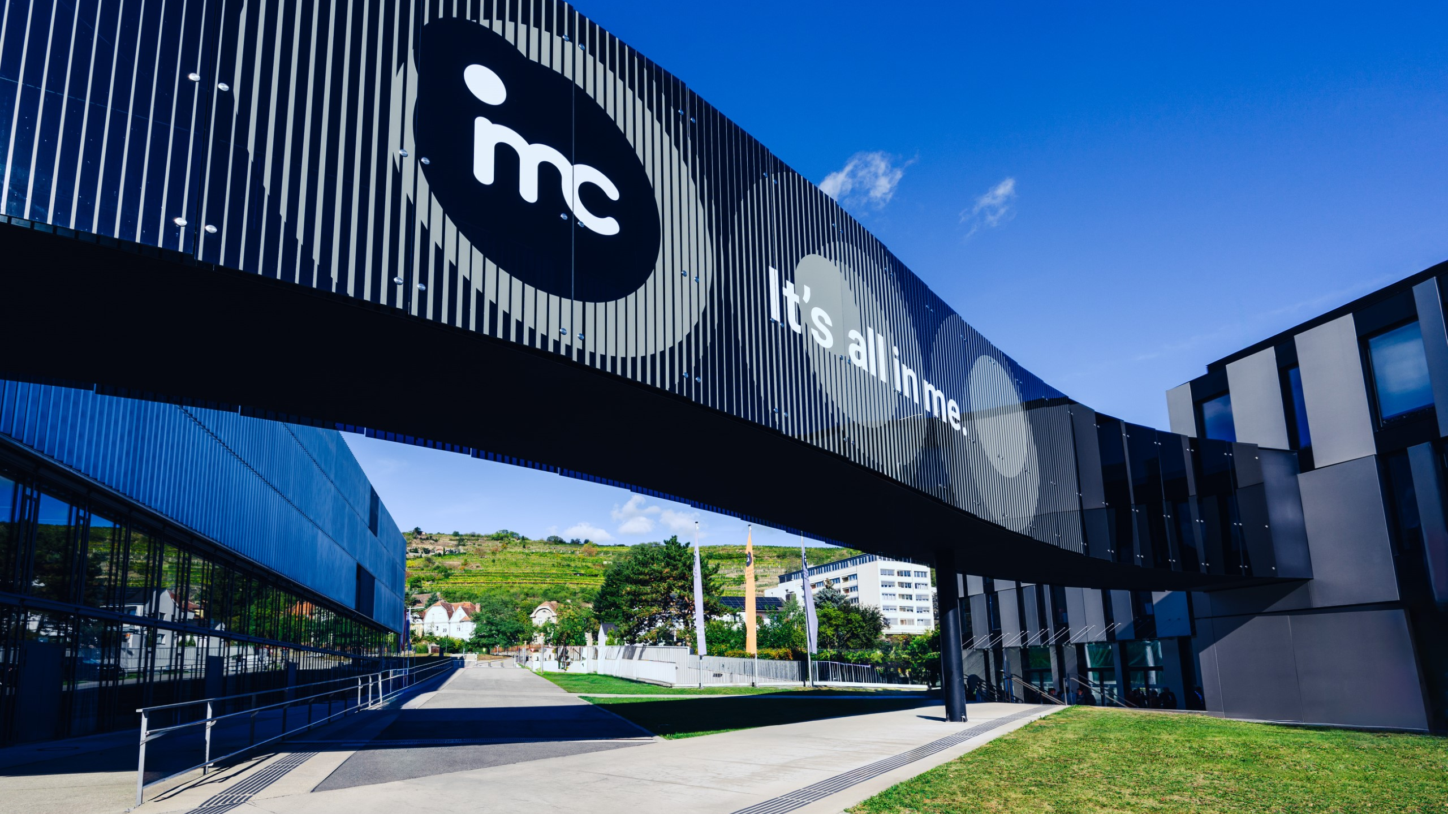
So long & cheerio!

